Slide 1
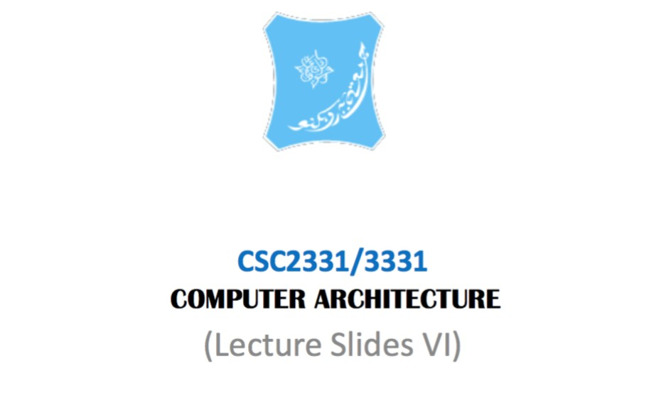

Slide 2
Overview
This lecture is about:
 Computer input and output devices
 How the processor communicates with these devices
 Bus architecture

Slide 3
Input devices
 An input device is any hardware component that allows users to enter data and instructions (programs, commands, and user responses) into a computer. Examples include:
 Keyboard
 Many people use a keyboard as one of their input devices. A keyboard is an input device that contains keys users press to enter data and instructions into a computer Desktop computer keyboards typically have from 101 to 105 keys.
 All desktop computer keyboards have a typing area that includes the letters of the alphabet, numbers, punctuation marks, and other basic keys. Many desktop

Slide 4
Pointing Devices
 A pointing device is an input device that allows a
 user to control a pointer on the screen. In a graphical user interface,
 a pointer is a small symbol on the screen whose location and shape change as a user moves a pointing device.
 A pointing device can be used to move the insertion point; select text, graphics, and other objects; and click buttons, icons, links, and menu commands.
 Examples:
 touch pad, Track ball, touch screens and touch sensitive pads

Slide 5
Output Devices
 An output device is any type of hardware component that conveys information to one or more people. Commonly used output devices Include
 display devices
 printers
 speakers
 headphones
 data projectors
 Interactive white boards
 force-feedback game controllers

Slide 6
Input - Output Interface
Input Output Interface provides a method for transferring information between internal
storage and external I/O devices.
Peripherals connected to a computer need special communication links for interfacing them
with the central processing unit.
The purpose of communication link is to resolve the differences that exist between the
central computer and each peripheral.

Slide 7
Input - Output Interface
The Major Differences are:-
1. Peripherals are electromechnical and electromagnetic devices and CPU and
memory are electronic devices. Therefore, a conversion of signal values may be
needed.
2. The data transfer rate of peripherals is usually slower than the transfer rate of CPU
and consequently, a synchronization mechanism may be needed.
3. Data codes and formats in the peripherals differ from the word format in the CPU and
memory.
4. The operating modes of peripherals are different from each other and must be
controlled so as not to disturb the operation of other peripherals connected to the
CPU

Slide 8
Input - Output Interface
The Major Differences are:-
1. Peripherals are electromechnical and electromagnetic devices and CPU and
memory are electronic devices. Therefore, a conversion of signal values may be
needed.
2. The data transfer rate of peripherals is usually slower than the transfer rate of CPU
and consequently, a synchronization mechanism may be needed.
3. Data codes and formats in the peripherals differ from the word format in the CPU and
memory.
4. The operating modes of peripherals are different from each other and must be
controlled so as not to disturb the operation of other peripherals connected to the
CPU

Slide 9
Communication between I/O devices and the OS
To Resolve these differences, computer systems include special hardware components between the CPU and Peripherals to supervises and synchronizes all input and out transfers
These components are called Interface Units because they interface between the
processor bus and the peripheral devices.

Slide 10
I/O command
Control command- A control command is issued to activate the peripheral and to inform it what to do.
Status command- A status command is used to test various status conditions in the interface and the peripheral.
Data Output command- A data output command causes the interface to respond by transferring data from the bus into one of its registers.
Data Input command- The data input command is the opposite of the data output.

Slide 11
Giving commands to I/O devices
 CPU must be able to address the device and to supply one or more commands
methods for addressing the device
Single Bus System
Shared Bus system
Memory Mapped I/O
Programmed I/O

Slide 12
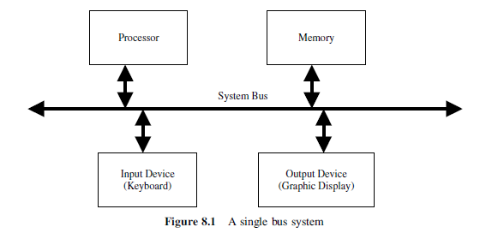
Single Bus System

Slide 13
Single Bus System
In the single bus System there are numbers of input and output register and each belonging to a single input device and same for the output devices and an address is assign to each of the above device and different from the address assign to memory

Slide 14
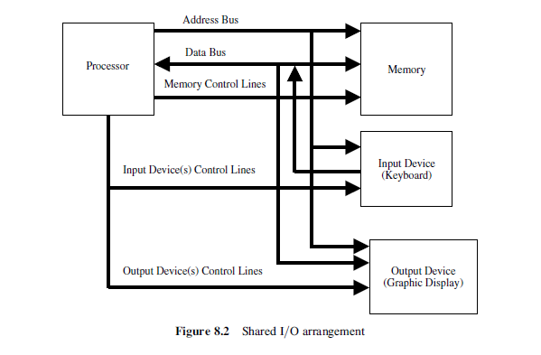
Shared I/O system

Slide 15
Shared I/O system
This arrangement, called shared I/O, is shown schematically, In this case, the address and data lines from the CPU can be shared between the memory and the I/O devices. A separate control line will have to be used. This is because of the need for executing input and output instructions. In a typical computer system, there exists more than one input and more than one output device. Therefore, there is a need to have address decoder circuitry for device identification. There is also a need for status registers for each input and output device.

Slide 16
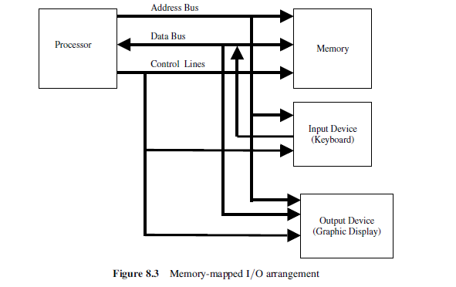
Memory Mapped I/O compare to the shared I/O the memory mapped uses same control lines for the I/O and the processor and memory

Slide 17
 Memory-mapped I/O addressing
 Portions of a program’s address space are assigned to I/O devices
 Reads and writes to these addresses are interpreted as commands to the device
 These memory addresses are not directly accessible by the user programs

Slide 18
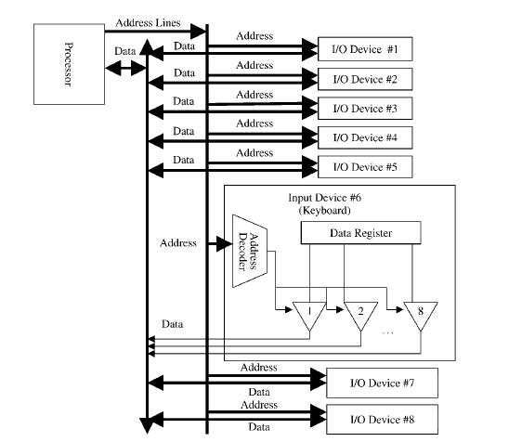
Programmed I/O In the programmed I/O the protocols has to be programmed in the form of routine that runs over the control of the CPU.

Slide 19
Communication with the Processor
 Two methods
 Polling
 Device status bits are periodically checked to see if it is time for the next I/O operation
 Interrupt-driven I/O
 Device delivers interrupt to the CPU when it requires attention
 Interrupts are like exceptions except that they are not associated with any instruction
 CPU can check before starting a new instruction if an interrupt has been delivered
 Interrupt-handling: Can be vectored or can use a Cause register

Slide 20
Transferring Data between Device and Memory
 Direct Memory Access (DMA)
 Data is transferred directly from the device to memory (or vice versa)
 Processor is only involved in
Initiating the DMA transfer
Handling interrupt at the end of DMA transfer

Slide 21
DMA
 Implemented with special controller that transfers data between memory and I/O device independent of the processor
 Three steps in DMA transfers
Processor sets up the DMA transfer by supplying identity of device, operation to perform, memory address that is source or destination of data, number of bytes to be transferred
DMA controller starts the operation (authorizes for the bus, supplies address, reads or writes data), until the entire block is transferred
DMA controller interrupts the processor, which then takes the necessary actions

Slide 22
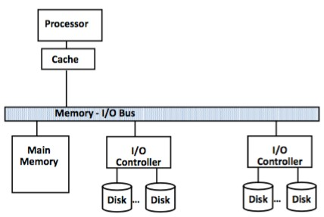
Basic I/O system example

Slide 23
Computer Buses
The bus is a critical component of the computer
 They are shared components that provide the paths for all parts of the computer to communicate with each other
 They can reduce the complexity of communications between computer components
 They can provide an easy way to evolve a computer system
add components
 They can be a serious bottleneck if not designed and used appropriately
 As systems grow, they need to evolve hierarchically
 They can be parallel or serial
 They can have data widths larger than the computer word length

Slide 24

Bus Basics
 A bus generally contains a set of control lines and a set of data lines
 The control lines are used to signal requests and acknowledgments, and to indicate what type of information is on the data lines
 The data lines of the bus carry information between the source and the destination.
 This information may consist of data, complex commands, or addresses.
 Buses are traditionally classified into two:
 processor-memory buses
 i/o buses

Slide 25
 The processor-memory bus
 A bus that connects processor and memory
 It is generally short and high speed
 Are interfaced to the memory system to maximize memory- processor bandwidth
 The i/0 buses
 Are lengthy
 can have many types of devices connected to them
 Do not typically interface directly to the memory but use either a processor-memory bus or a backplane bus to connect to memory

Slide 26
Bus Design: Things To Consider
 Some of the parameters to consider when designing a computer bus:
 Accessibility
 Speed
 Reliability
 Interfacing
 Communication protocol
 Shareability
 length

Slide 27
Bus Communication Protocol
Two types:
 synchronous
 Asynchronous
 Synchronous ( e.g. processor- memory Bus)
 Includes a clock in the control lines and has a fixed protocol for communication that is relative to the clock
Advantage
 Involves very little logic and can run very fast Disadvantages:
 Every device communicating on the bus must use same clock rate
 To avoid clock skew, the bus lines cannot be long if they are fast.

Slide 28
 Asynchronous
This Scheme is used when speed of I/O devices do not match with microprocessor, and timing characteristics of I/O devices is not predictable. In this method, process initiates the device and check its status. As a result, CPU has to wait till I/O device is ready to transfer data. When device is ready CPU issues instruction for I/O transfer. In this method two types of techniques are used based on signals before data transfer
i. Strobe Control
ii. Handshaking

Slide 29
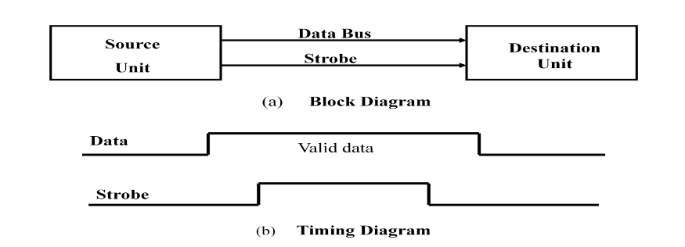
Strobe Signal
The strobe control method of Asynchronous data transfer employs a single control line to time each transfer. The strobe may be activated by either the source or the destination unit.

Slide 30
Disadvantage of Strobe Signal :
The disadvantage of the strobe method is that, the source unit initiates the transfer has no way of knowing whether the destination unit has actually received the data item that was places in the bus. Similarly, a destination unit that initiates the transfer has no way of knowing whether
the source unit has actually placed the data on bus. The Handshaking method solves this
problem.

Slide 31
Handshaking
The handshaking method solves the problem of strobe method by introducing a second control signal that provides a reply to the unit that initiates the transfer.
One control line is in the same direction as the data flows in the bus from the source to destination. It is used by source unit to inform the destination unit whether there a valid data in the bus. The other control line is in the other direction from the destination to the source. It is used by the destination unit to inform the source whether it can accept the data. The sequence of control during the transfer depends on the unit that initiates the transfer

Slide 32
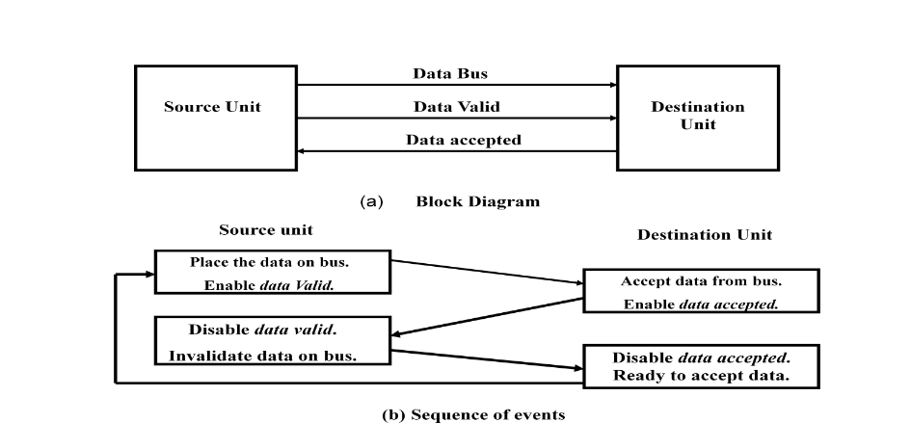
Handshaking

Slide 33
Handshaking
Destination Initiated Transfer Using Handshaking:
The name of the signal generated by the destination unit has been changed to ready for data to reflects its new meaning. The source unit in this case does not place data on the bus until after it receives the ready for data signal from the destination unit. From there on, the handshaking procedure follows the same pattern as in the source initiated case. The only difference between the Source Initiated and the Destination Initiated transfer is in their choice of Initial sate.

Slide 34
Handshaking
Advantage of the Handshaking method:
The Handshaking scheme provides degree of flexibility and reliability because the
successful completion of data transfer relies on active participation by both units.
If any of one unit is faulty, the data transfer will not be completed. Such an error can
be detected by means of a Timeout mechanism which provides an alarm if the data is
not completed within time.

Slide 35
Asynchronous Serial Transmission:
The transfer of data between two units is serial or parallel.
In parallel data transmission, n bit in the message must be transmitted through n separate conductor path.
In serial transmission, each bit in the message is sent in sequence one at a time.
Parallel transmission is faster but it requires many wires. It is used for short distances and where speed is important. Serial transmission is slower but is less expensive.

Slide 36
Asynchronous Serial Transmission:
In this technique each character consists of three points :
i. Start bit
ii. Character bit
iii. Stop bit
Start Bit- First bit, called start bit is always zero and used to indicate the beginning character.
ii. Stop Bit- Last bit, called stop bit is always one and used to indicate end of characters. Stop bit is always in the 1- state and frame the end of the characters to signify the idle or wait state.
iii. Character Bit- Bits in between the start bit and the stop bit are known as character bits. The character bits always follow the start bit.

Slide 37
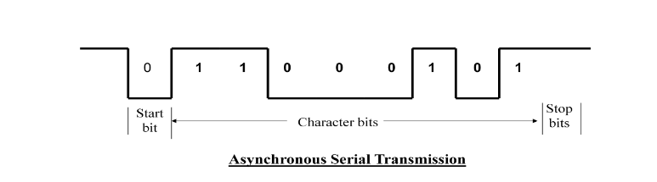
Asynchronous Serial Transmission:

